Slide 1
Computer Basics
KOHS Cyber Training Portal

Slide 2
Outline:
0. What is a computer?
0.1. Parts:
0.1.1. RAM
0.1.2. Storage
0.1.3. CPU
0.1.4. Graphics Card
0.1.5. Mother Board
0.1.6. Power Supply
0.2. Computer Operations
0.2.1. BIOS
0.2.2. OS
0.2.3. Applications
0.2.4. User Interface (GUI)

Slide 3
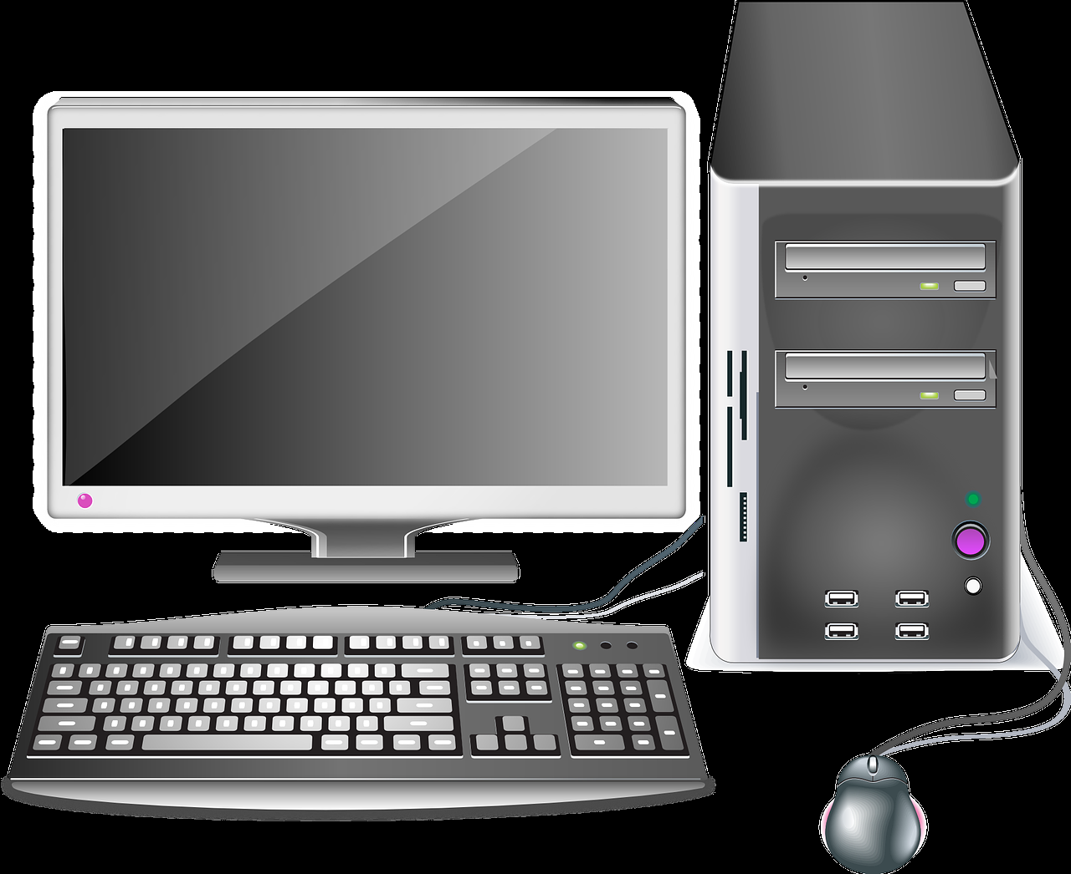
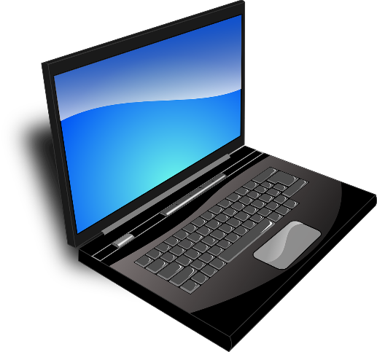

What is a computer?
A computer is a device which lets you manipulate data through the ability to store, receive, and process information
There are three main types of computers:
Desktops
Laptops
Tablets
Computers are made up of multiple types of hardware and software that enables the functions and graphics you see on screen

Slide 4
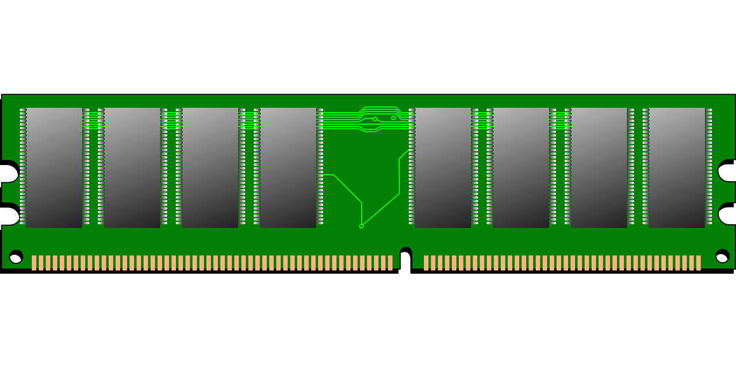
Parts of a Computer: RAM
Random Access Memory, or RAM, is the short term memory of your computer.
This data allows you to quickly access the more information at the same time
It is much quicker for data to be stored in RAM than on your hard drive, but it can’t be stored long-term

Slide 5
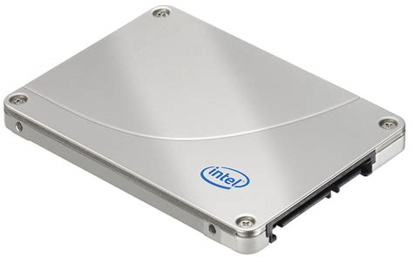
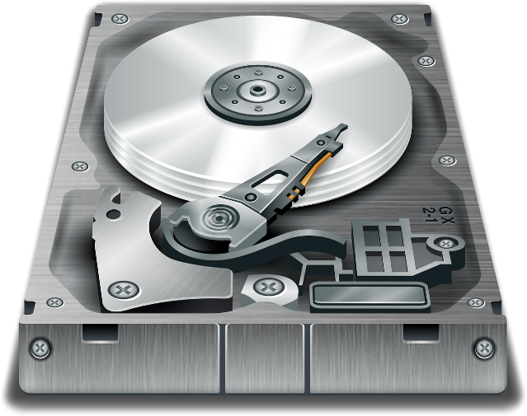
Parts of a Computer: Hard Drive
Unlike RAM, your hard drive allows for long term storage of your data
There are two main types of internal hard drives:
Hard disk drives
Solid state drives
The storage in your hard drive allows you to access data after you have turned your computer back on
External hard drives can be used to add additional storage

Slide 6
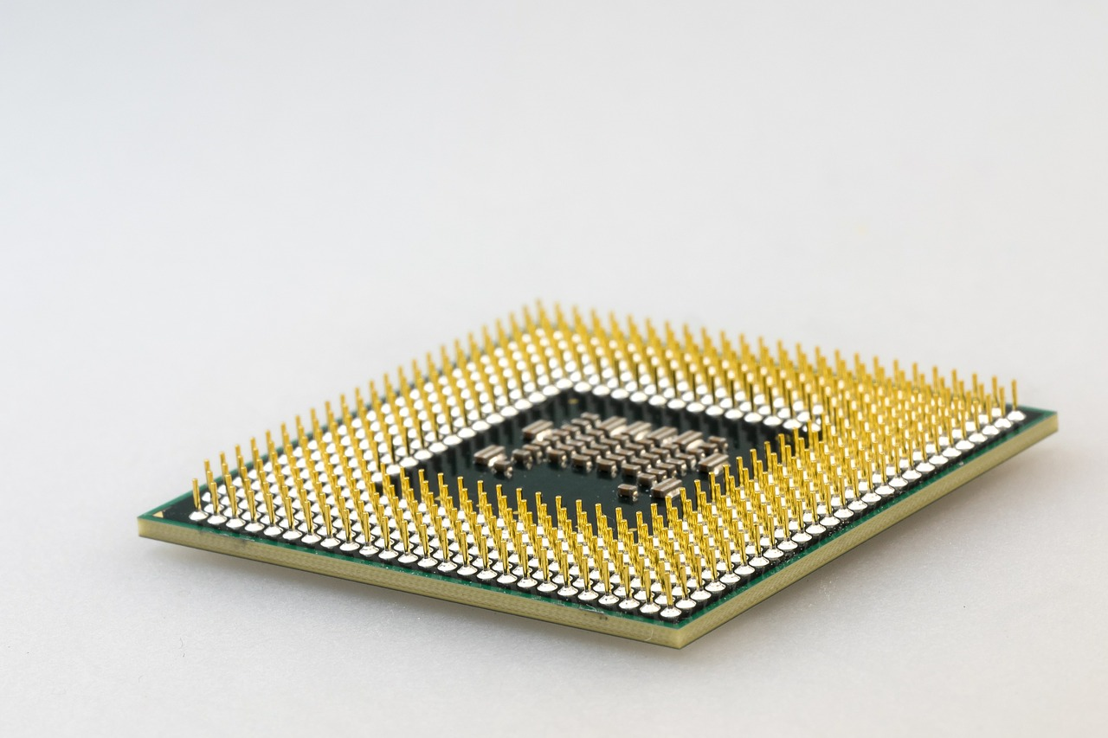
Parts of a Computer: CPU
your Central Processing Unit, or CPU, processes or runs the commands given to your computer
CPUs can run at different speeds measured in gigahertz (GHz)

Slide 7
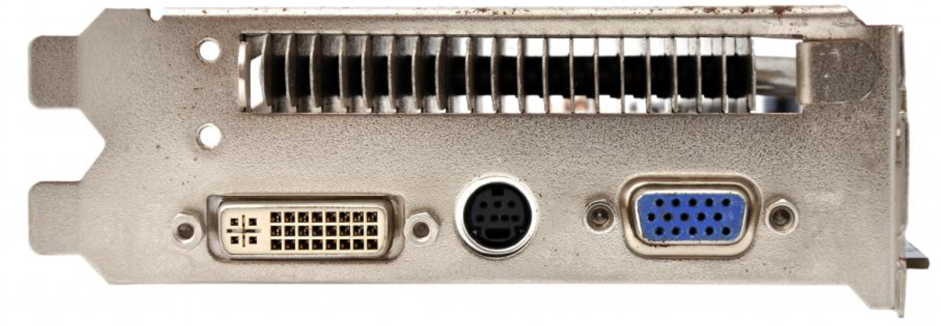
Parts of a Computer: Graphics Card
A graphics card enables the screen to show images
Connected to the graphics processing unit, a graphics card, is responsible for the resolution and quality of the graphics displayed

Slide 8
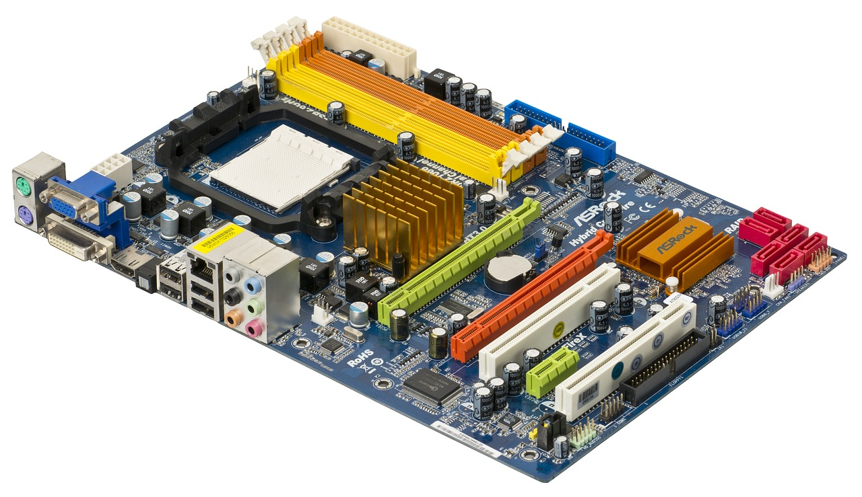
Parts of a Computer: Motherboard
Every part of a computer leads back to the motherboard
The motherboard links all of the parts of a computer together and allows all of the parts to work together
Graphics, storage, and functions come together in the motherboard

Slide 9
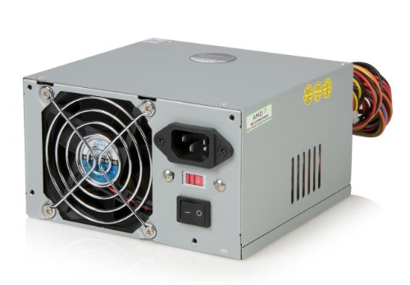
Parts of a Computer: Power Supply
Without a source of power, none of the parts mentioned above would work
Your computer’s power supply unit (PSU), converts power from alternating current to direct current
The PSU also regulates voltage to control overheating

Slide 10

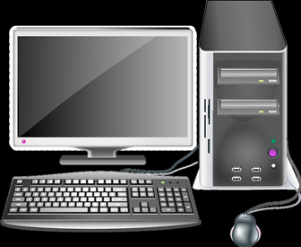
Game: Computer Repair
So, thought for the game is to have a computer with a problem, (overheating picture could be a computer with a thermometer, no graphics could be a blank screen, etc) then have the player select the part to repair. Ex:
Select which part will fix the computer:
RAM
Storage
CPU
Graphics Card
Motherboard
Power supply
Fix the computer:
(short term memory loss,
Click RAM)

